Slide 1
System Architectures in Distributed Systems
Exploring Different Architectural Models and Their Applications

Slide 2
What is System Architecture?
System architecture defines how components of a distributed system are organized and interact. It determines communication patterns, data flow, and the level of coupling between system components.

Slide 3
Common Distributed System Architectures
• Layered Architecture
• Client-Server Architecture
• Peer-to-Peer (P2P) Architecture
• Service-Oriented Architecture (SOA)
• Microservices Architecture
• Cloud and Edge Computing

Slide 4
Layered Architecture
Organizes system components into layers such as presentation, application, and data layers. Each layer provides services to the layer above and relies on the layer below.

Slide 5
Client-Server Architecture
In this model, clients request services and servers provide them. It’s one of the most common forms used in web systems, databases, and file sharing.

Slide 6
Peer-to-Peer Architecture
All nodes act as both clients and servers, sharing resources without centralized control. Examples include file sharing systems like BitTorrent and blockchain networks.

Slide 7
Service-Oriented and Microservices Architecture
SOA divides functionality into independent services that communicate over a network.
Microservices extend this idea with finer granularity, allowing each service to be independently deployed and scaled.

Slide 8
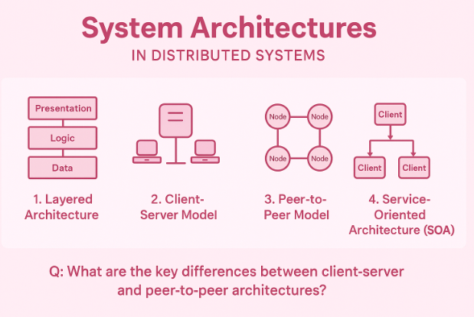

Slide 9
Cloud and Edge Computing Architectures
Cloud architecture centralizes resources in data centers.Edge computing brings computation closer to users, reducing latency and improving response time.

Slide 10
Choosing the Right Architecture
The choice depends on system goals such as scalability, latency, fault tolerance, and cost. Many modern systems use hybrid architectures combining multiple models.

Slide 11
Discussion and Review Questions
1. What role does system architecture play in distributed systems?
2. Compare client-server and peer-to-peer architectures.
3. What are the advantages of layered architecture?
4. How does microservices architecture improve scalability and flexibility?
5. What are the main differences between cloud and edge architectures?
6. In what scenarios would you use a hybrid architecture?
7. Explain how architecture affects performance and fault tolerance.

